Slide 1

Erasmus+
Changing lives, opening minds!
Youth Mobility
Presentation by Tomislav Bogdan
YE „Equality Timeline”
#EqualityTimeline #cetHR #cetplatform #erasmusplus
01.10. – 09.10. 2019.
Đakovo, Croatia

Slide 2








2014-2020
7 former EU programes merged into “Erasmus+”

Slide 3
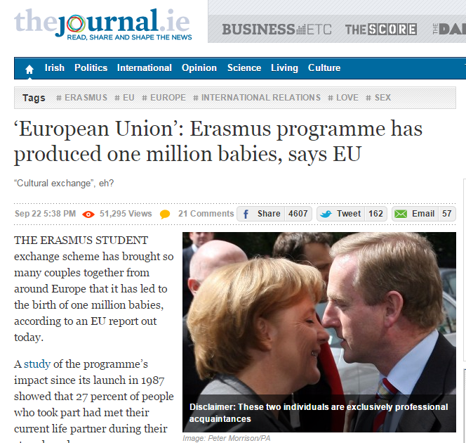
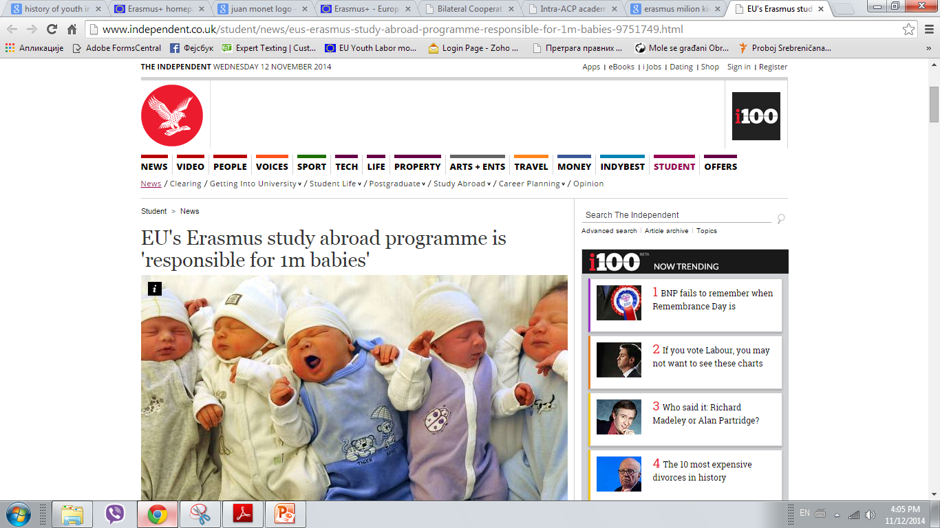
Youth in Action and Erasmus were one of the most effective EU programmes

Slide 4
ERASMUS+ IS FOR...
Higher education
Vocational education and training
Schools
Youth
Sport
Adult education

Slide 5
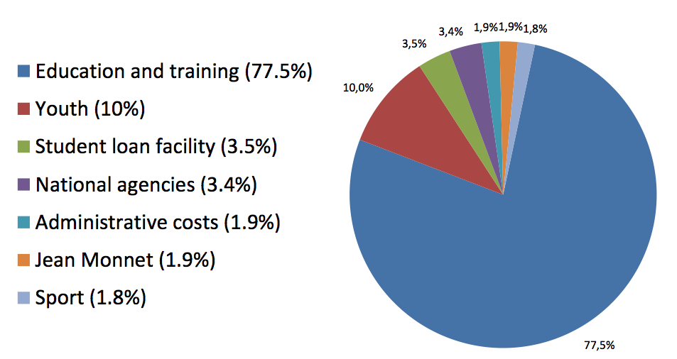
BUDGET ALLOCATION PER SECTOR
Total budget: 14.774 billion euro
Expansion from 2020. – 2017.: >30 billion euros

Slide 6

WHY ERASMUS+?
Education, training and youth: a changing landscape
Deep economic crisis and high youth unemployment
Societal crisis (intolerance, social exclusion decreased well-being and autonomy)
- Almost ¼ of European citizens are at the risk of social exclusion and poverty!
Vacancies exist, but skills gaps and low employability of graduates
- 6m young people are unemployed, but there’re over 2m job vacancies!
Growing requirement for high skilled jobs
A global competition for talent: internationalisation of education
Complementarity between formal, informal and non formal learning
Need for closer links with world of work
Contributes to European Union Policy: Europe 2020, EU Strategy for Youth, Renewed framework for European cooperation in the youth field (2010-2018)

Slide 7
AIMS and CARACTERISTICS
Improving skills and employability
Supporting the modernisation of education, training and youth systems
Develop cooperation between different sectors and with the world of work, especially with companies
Simplification of application rules and procedures
European added value
Increased focus on results and impact of projects supported

Slide 8
GENERAL OBJECTIVES OF E+
the objectives of the Europe 2020 Strategy, including the headline education target ;
the objectives of the strategic framework for European cooperation in education and training (ET 2020), including the corresponding benchmarks;
the sustainable development of Partner Countries in the field of higher education;
the overall objectives of the renewed framework for European cooperation in the youth field (2010-2018);
the objective of developing the European dimension in sport, in particular grassroots sport, in line with the EU work plan for sport;
the promotion of European values in accordance with Article 2 of the Treaty on the European Union.

Slide 9
SIMPLY, ERASMUS+ AIMS TO:
→ Boost skills and employability
→ Modernise education, training and youth work
→ Focus on young people, especially those with fewer opp.

Slide 10
Structure of Erasmus+
Key Action 1: MOBILITY OF INDIVIDUALS
Key action 3: support for POLICY REFORMS
Jean Monnet
Sport
Key action 2: COOPERATION for innovation and the exchange of good practices

Slide 11
KA1 – Mobility of individuals
Mobility of learners and staff
  For Higher Education Students and Staff
  For VET Learners and Staff
  For School Education Staff
  For Adult Education Staff
  For Young People and Youth Workers
Joint Master Degrees
Master Student Loan Guarantee

Slide 12
KA 2 – Cooperation for innovation and exchange of good practce
Strategic Partnerships (Higher education+Training+Youth)
Knowledge Alliances (HE with Business)
Sector Skills Alliances (between sectors for skill gaps)
Capacity Building projects
  In Higher Education
  In The Field of Youth
    Western Balkan Youth Window
    Eastern European and Tunisia Youth Window
IT support platforms: eTwinning, the European Platform for Adult Learning (EPALE) and the European Youth Portal

Slide 13
KA 3 – Support for policy reforms
Knowledge in the fields of education, training and youth
Prospective initiatives
Support to European policy tools
Cooperation with international organisations
Stakeholder dialogue, policy and Programme promotion

Slide 14
JEAN MONNET ACTIVITIES
Academic Modules, Chairs, Centres of Excellence
Policy debate with academic world
Support to institutions and associations
Studies and conferences

Slide 15
SPORT
Collaborative Partnerships
Not-for-profit European sport events
Strengthening of the evidence base for policy making
Dialogue with relevant European stakeholders
Presidency events

Slide 16
WHO CAN APPLY?
NGOs (foundations, registered charities, limited company - no share capital) active in education, training, youth and sport;
Public bodies;
Private limited companies;
Some youth projects allow informal groups of young people to apply (one member of the group must be aged 18-30).

Slide 17
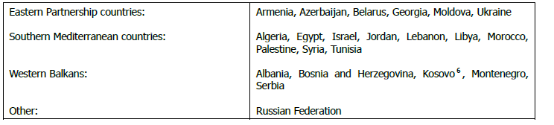
ELIGIBLE COUNTRIES
Programme Countries: can fully take part
28 EU Member States + EFTA (Iceland, Liechtenstein, Norway) + Macedonia + Turkey + Serbia (2019.)
Partner Countries: can take part in certain Actions
Other Partner Countries: Actions with broader geographical scope

Slide 18
YOUTH MOBILITY
Erasmus+
  Key Action 1
    Mobility of young people and youth workers
      Mobility of Young People (Youth Exchanges)
      European Voluntary Service (EVS)
      Mobility of Youth Workers (Trainings, Seminars, PBA, Study visits, Job shadowing)

Slide 19
Mobility of Young People
(Youth Exchanges)
Youth Exchanges allow groups of young people from different countries to meet and live together for up to 21 days
For young people who are mostly unexperienced on the topic
Age limit of 13 to 30 years old
Minimum group size is 5 (4+1 youth leader)
Youth leaders are experienced persons who are responsible for their national groups and lead the sessions; No trainers.
Youth leaders have no age limit and need to be over 18 years old

Slide 20
Mobility of Young People
(Youth Exchanges)
Duration of youth exchanges can be from 5 to 21 days
Minimum 16 and maximum 60 participants (excluding leaders)
Bi, Tri, Multilateral exchanges
Wider topics and expected final output/event/exebition/product…
Possibility for APV (Advance Plan Visit) up to maximum of 2 days

Slide 21
European Voluntary Service (EVS)
EVS (ESC) allows young people aged 17-30 to express their personal commitment through unpaid and full-time voluntary service for up to 12 months in another country within or outside the European Union
Young volunteers are given the opportunity to contribute to the daily work of organisations dealing with different kind of topics and target groups
A project can include between 1 and 30 volunteers who can do their voluntary service either individually or in group
Short term (only for large scale EVS) from 2 weeks to 2 months
Long term from 2 to 12 months

Slide 22
European Voluntary Service (EVS)
Free of charge (accommodation, food, materials, language course and monthly allowance is provided by the project grant)
Organisations need to be accredited by NA’s or regional SALTO
Sending, coordinating and receiving organisations
Each volunteer has a) an on-arrival training; b) a mid-term evaluation (for voluntary services lasting more than 6 months)
Each volunteer has SIGNA insurance

Slide 23
Mobility of Youth workers
Training and Networking
Supports the professional development of youth workers, through the implementation of activities such as international seminars, training courses, contact-making events, study visits, PBA’s or job shadowing/observation periods abroad in an organisation active in the youth field
Duration: From 2 days to 2 months (usually 7 to 10 days)
No age limits. Participants must be resident in the country of their sending or receiving organisation
Maximum up to 50 participants (including trainers and staff)
Trainers/Experts are facilitating the activities and are in charge of the working programme

Slide 24
PROJECT CYCLE FOR KA1: YOUTH
Project idea + Research of needs
Concluding partnership
Submit application
Selection results
Implementation of project activities
Reporting
Sign agreement and get money (40-80%)
If everything is fine, getting rest of money (20-60%)

Slide 25
AWARD CRITERIA KA1: YOUTH
Relevance of the project (maximum 30 points)
Quality of the project design and implementation (maximum 40 points)
Impact and dissemination (maximum 30 points)
To be considered for funding, proposals must score at least 60 points. Furthermore, they must score at least half of the maximum points in each of the categories of award criteria mentioned above.

Slide 26
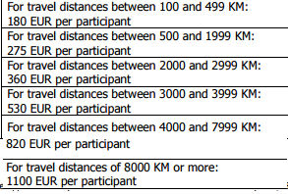
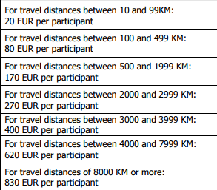
FUNDING RULES
Organisational support
No. of participants x Days of activity x Ammount depending of country
(e.g. 30 x 7 x 45 = 9450 euro)
Travel costs (based on distance calculator)
Special needs support (for participants with disabilities and accompanying persons)
Exceptional costs (visa costs, vaccinations, residence permits etc.)

Slide 27

DEADLINES
3 deadlines in 2019:
12. February
30. April
1. October
1 WB and EE window deadlines:
5. February

Slide 28

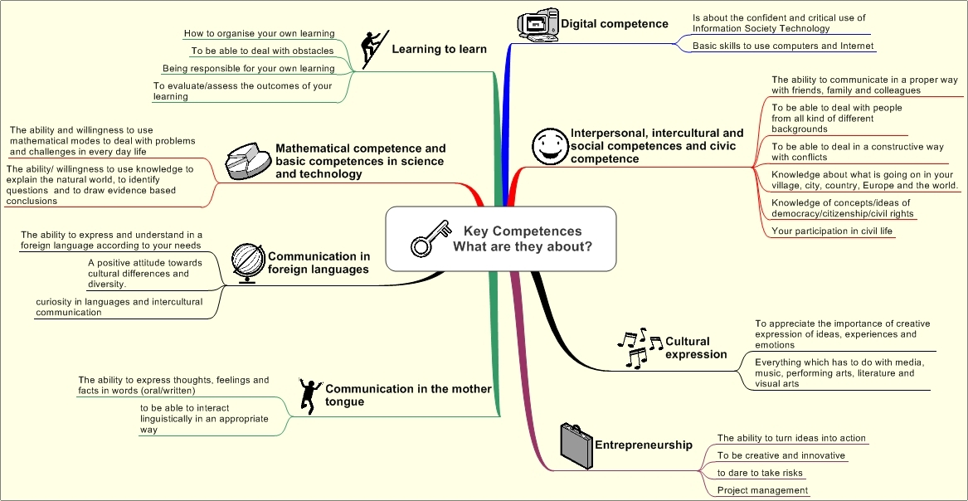
YOUTHPASS
Youthpass is a European recognition tool for non-formal and informal learning in youth work. It is also a certificate that proves the participation on youth projects.
Youthpass is for projects funded by Erasmus+ Youth in Action and Youth in Action programmes.
With Youthpass the participants of these projects can describe what they have done and show what they have learnt.

Slide 30
FIND OUT MORE
Where can I find out more?
ec.europa.eu/erasmus-plus
Erasmus+ programme guide:
http://ec.europa.eu/programmes/erasmus-plus/documents/erasmus-plus-programme-guide_en.pdf
How do I apply?
Contact the Erasmus+ National Agency in your home country or the Executive Agency (EACEA) in Brussels.
ec.europa.eu/erasmus-plus/na

Slide 31


Thank you for your attention!
You may now clap ☺
Tomislav Bogdan
croatia@cetplatform.org
/cetplatformahrvatska

Slide 32


